Slide 1
SRM CAST
Exploring Opportunities Beyond the Classroom
PODCAST

Slide 2
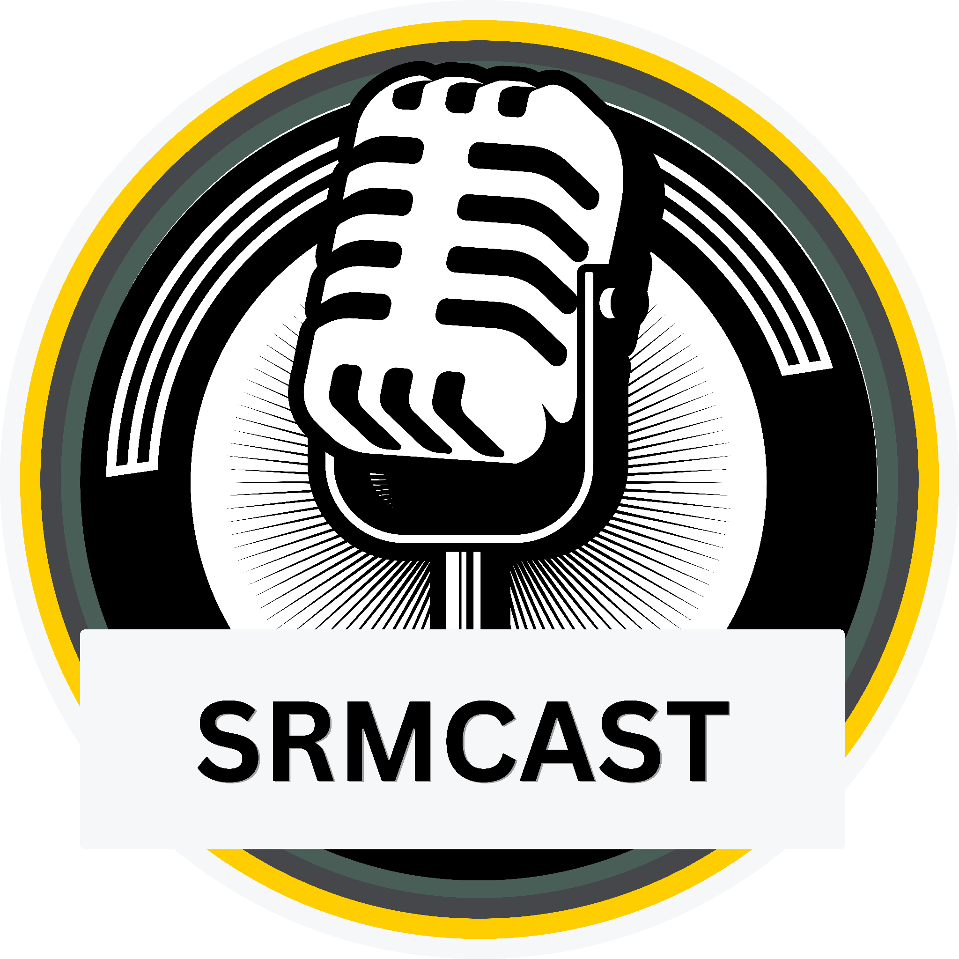
Introduction
SRM CAST
We, the students of SRM, have deep roots in every field. We explore, innovate, and succeed. Students at SRM are engaged in diverse activities and have much more to share. Therefore, we are introducing a special podcast series to enlighten other students about the possibilities that await them in their surroundings.

Slide 3
Objective
TALK 01
Create a compelling podcast series involving HODs, teachers, and students.
Provide real-world insights to bridge the gap between classroom learning and practical application.
Empower students to make informed decisions about their academic and career trajectories.

Slide 4
Benefits to Students
Industry trend insights.
Practical career guidance.
Holistic education understanding.
Networking opportunities.
Inspiration and motivation.
Personal and professional growth.
Empowered academic and career control.
TALK 02

Slide 5
Benefits to College
Enhanced Reputation
Increased Engagement
Attractiveness to Prospective Students
Positive Campus Culture
Professional Development
Social Media Presence
Enhanced Learning Experiencial knowledge
TALK 03

Slide 6
Conclusion
Our podcast series is the gateway to SRM's diverse student experiences. By connecting with HODs, teachers, and fellow students, we aim to inspire, inform, and empower. As we delve into industry trends, offer practical guidance, and explore holistic education, we're not just enhancing individual journeys but elevating SRM's reputation, fostering engagement, and shaping a positive campus culture.

Slide 7
Thanks
PODCAST

